Slide 1
WIND ENERGY
PORT OF SALACGRIVA - STRATEGIC BUSINESS PARTNER IN THE GULF OF RIGA

Slide 2
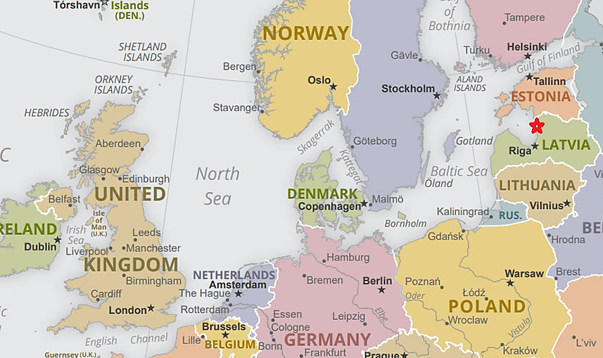
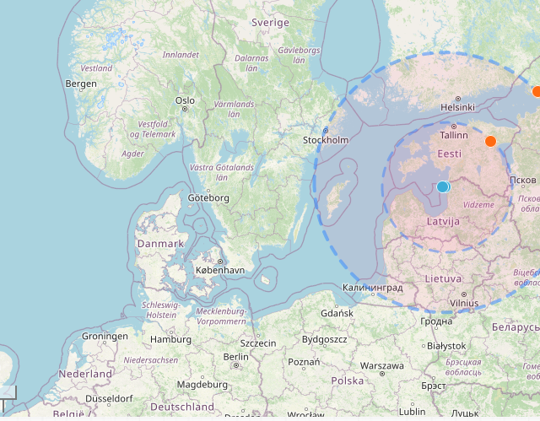
PORT OF SALACGRIVA GOOD BASE FOR DEVELOPERS AND OPERATORS; AND SUPPLY CHAIN COMPANIES
GOOD LOCATION TO ACCESS OWF DEVELOPMENTS IN TWO COUNTRIES – LATVIA AND ESTONIA

Slide 3
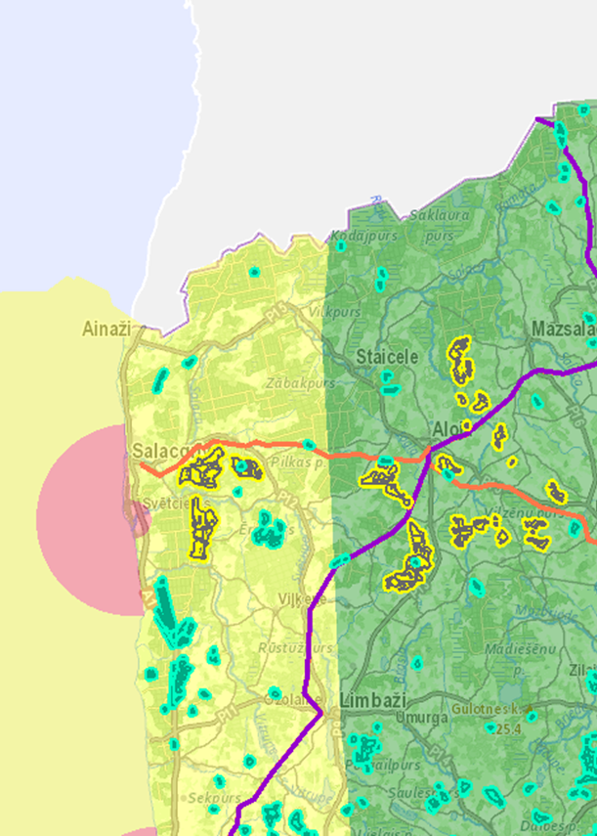
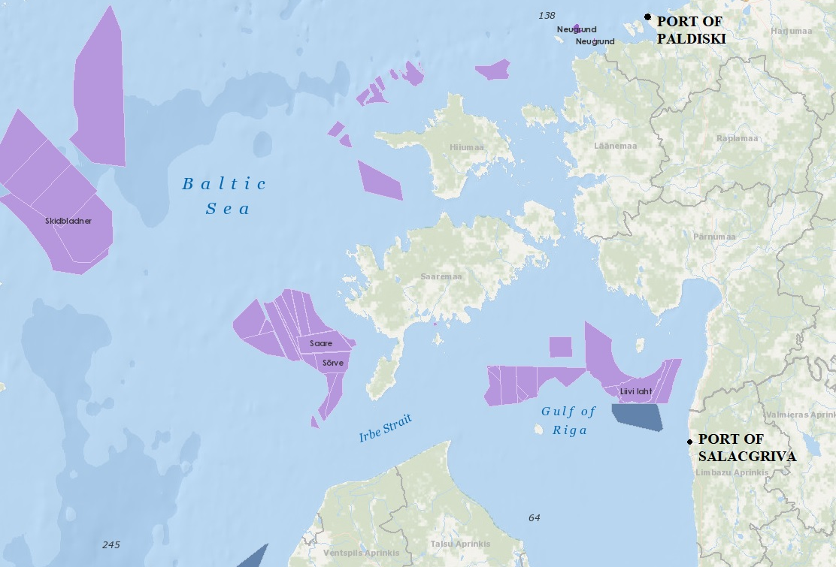
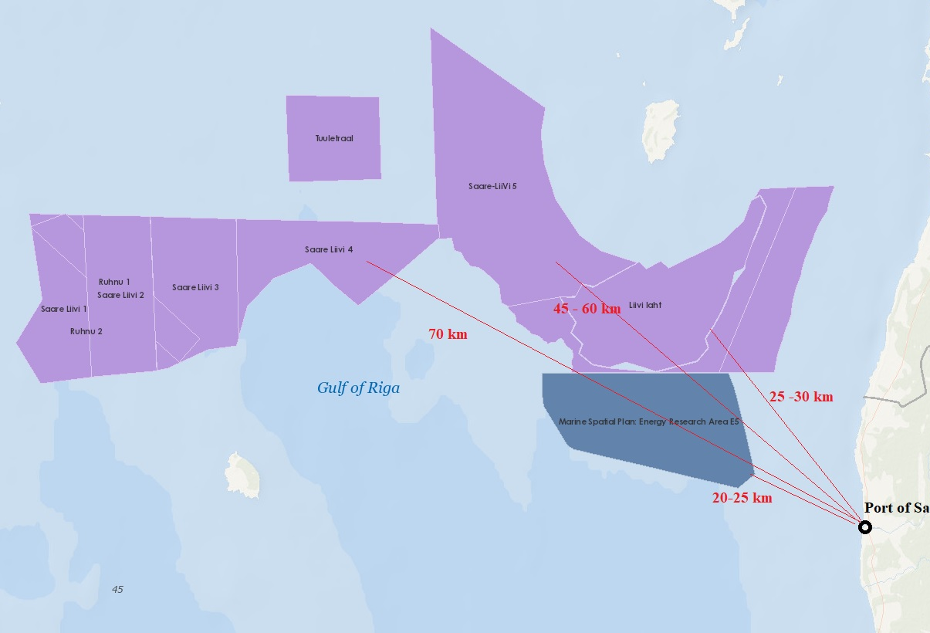
PORT OF SALACGRIVA ONSHORE AND OFFSHORE WIND PROJECTS
PORT CAN SUPPORT THE BUSINESSES
ESTABLISHED AND OPERATING PORT
WE CAN DEVELOP THE PORT WITH THE CLIENTS SPECIFICATIONS

Slide 4
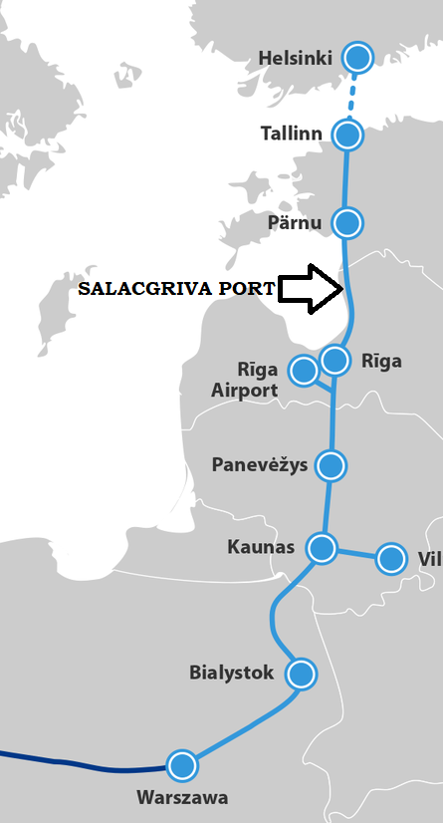
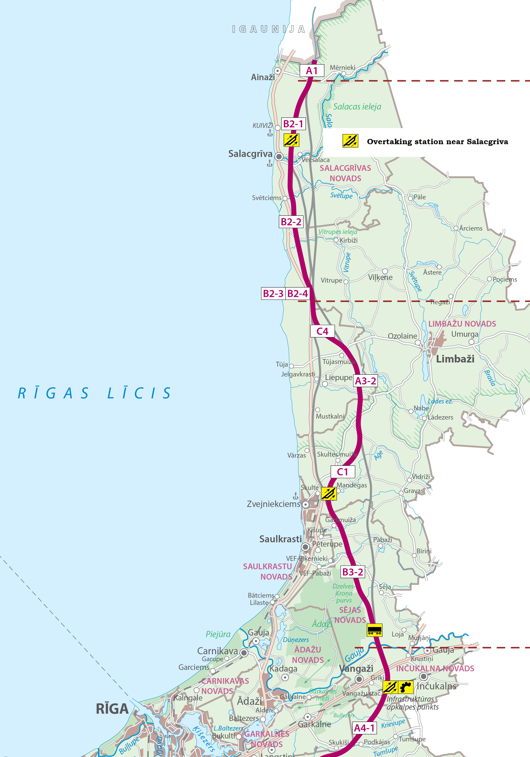
PORT OF SALACGRIVA EASY ACCESS FROM SEA AND LAND
SALACGRIVA IS LOCATED ON VIA BALTICA – THE MAIN HIGHWAY CONNECTING HELSINKI-TALLINN-RIGA-KAUNAS-WARSAW
RAIL BALTICA PLANS A CARGO AND PASSENGER STATION 3 KM FROM SALACGRIVA PORT

Slide 5
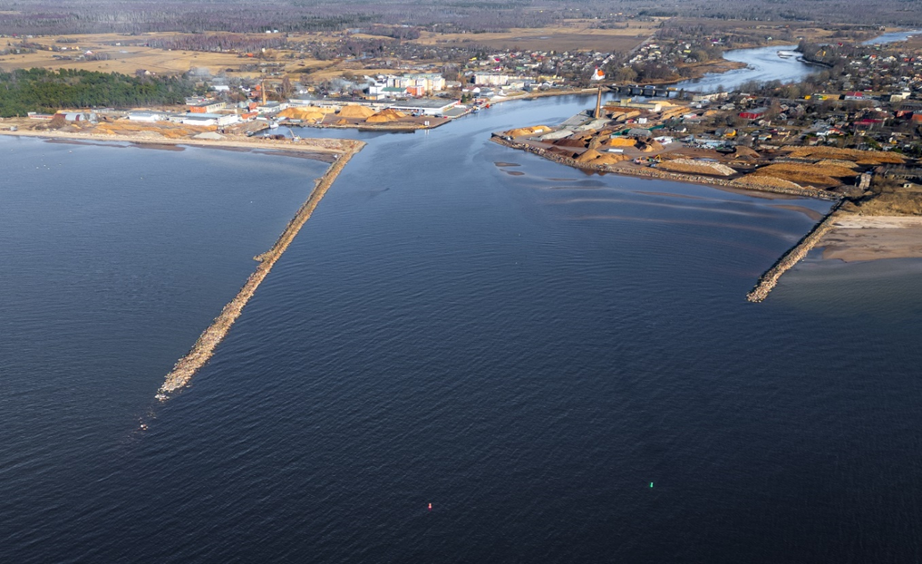
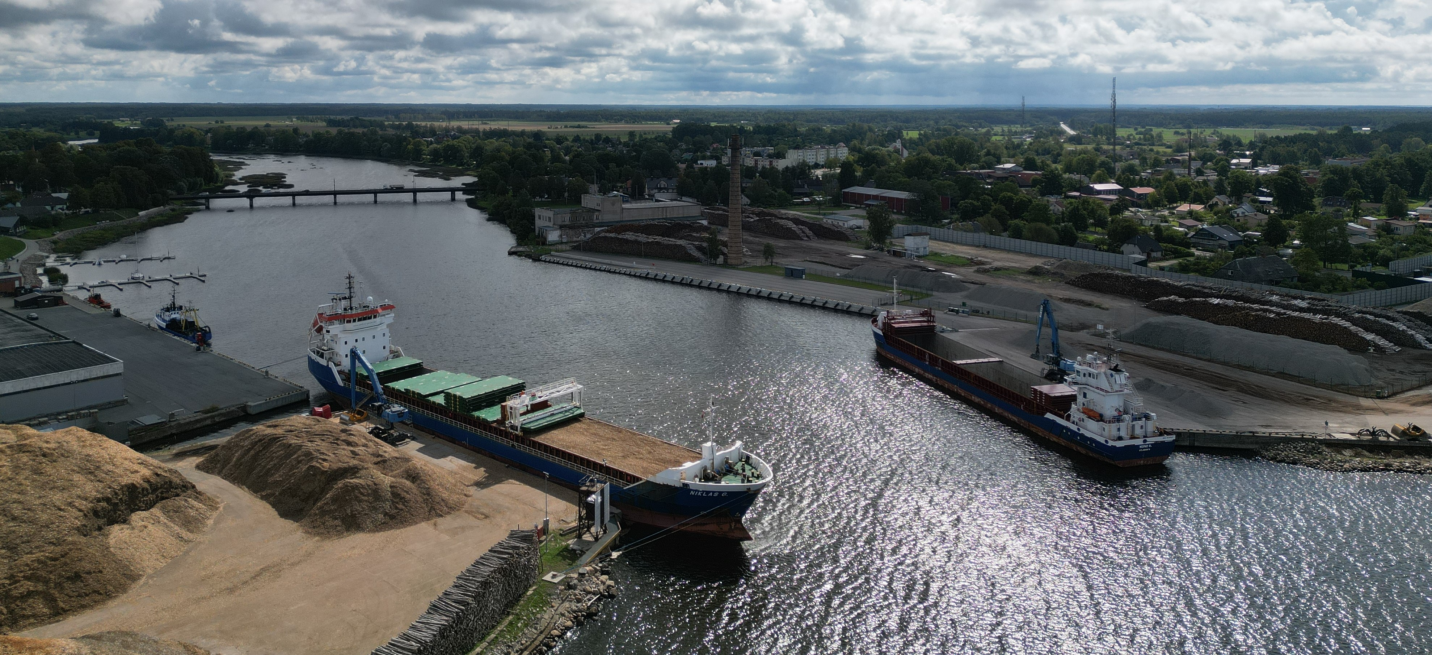
PORT OF SALACGRIVA CARGO, FISHING AND YACHT PORT
THE EXISTING PORT AREA (LAND) ~ 15 HA
SHIP’S DRAFT: -5,6 M, LOA 115M
CARGO SHIPPING TRAFFIC: 15 VESSELS PER MONTH
FISHING FACTORY, FISHING SHIPS
YACHT PORT

Slide 6
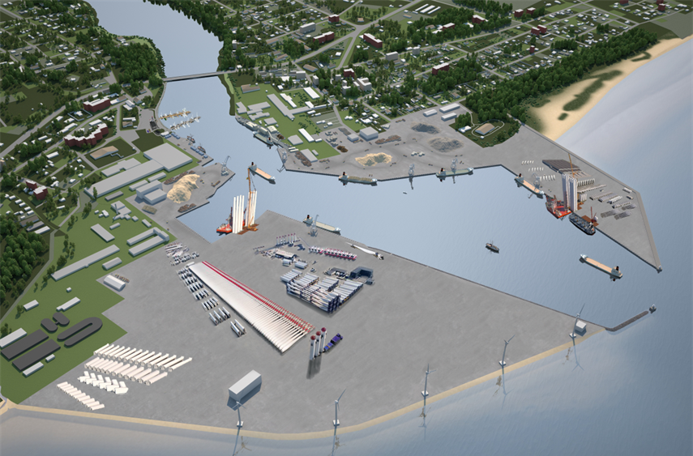
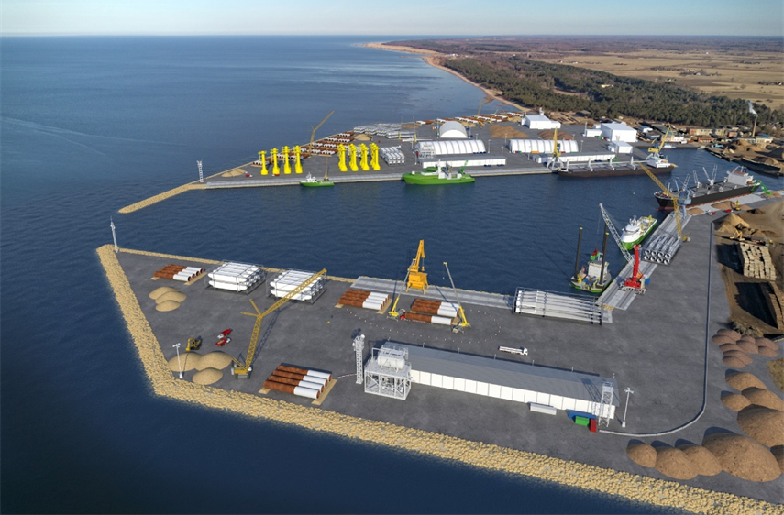
DEVELOPMENT OF PORT OF SALACGRIVA CONSTRUCTION & INSTALLATION
AVAILABLE NEW AREA FOR DEVELOPMENT, EIA DONE.
PORT DEVELOPMENT PLAN ALLOWS AN EXTRA TERRITORY UP TO 55 HA TO BE BUILT.
ESTIMATED DEPTHS ALONGSIDE BERTHS PLANNED -7 M .
ESTIMATED WIDTH OF THE CHANNEL PLANNED -80 M.
FUTURE DEPTHS POSSIBLE -10-11 M.
FUTURE WIDTH OF THE CHANNEL POSSIBLE 120 M.

Slide 7
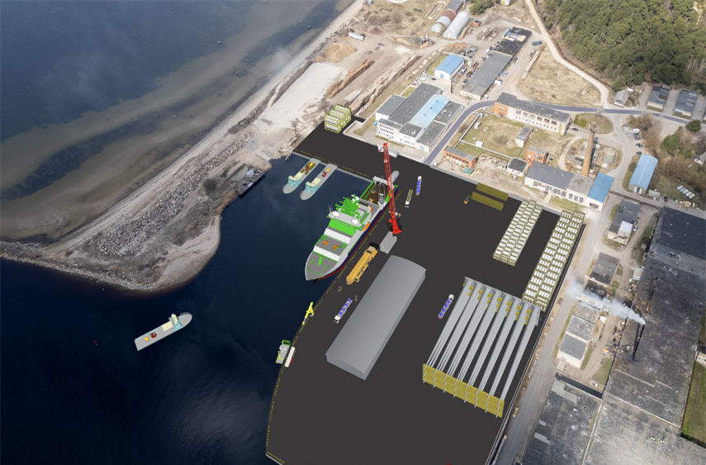
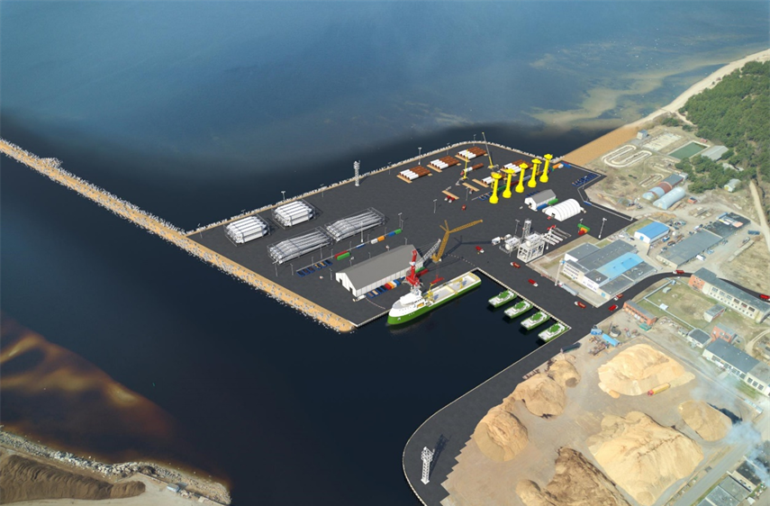
DEVELOPMENT OF PORT OF SALACGRIVA OPERATIONS & MAINTENENCE
OUTER SEA EXTENSION ALLOWED BY EIA
VARIOUS SOLUTIONS FOR THE O&M TERRITORY
EXISTING PARTNERS TO CONSTRUCT AND LEASE THE O&M FACILITY, EXISTING INFRASTRUCTURE CAN BE REPURPOSED, WAREHOUSES JUST OUTSIDE THE PORT AREA MAY BE LEASED OR POTENTIALLY PURCHASED
THE PORT HAS A PARTNER FOR ACCOMMODATION & OFFICE DEVELOPMENT - RS DIVING CONTRACTOR GMBH (DE)

Slide 8
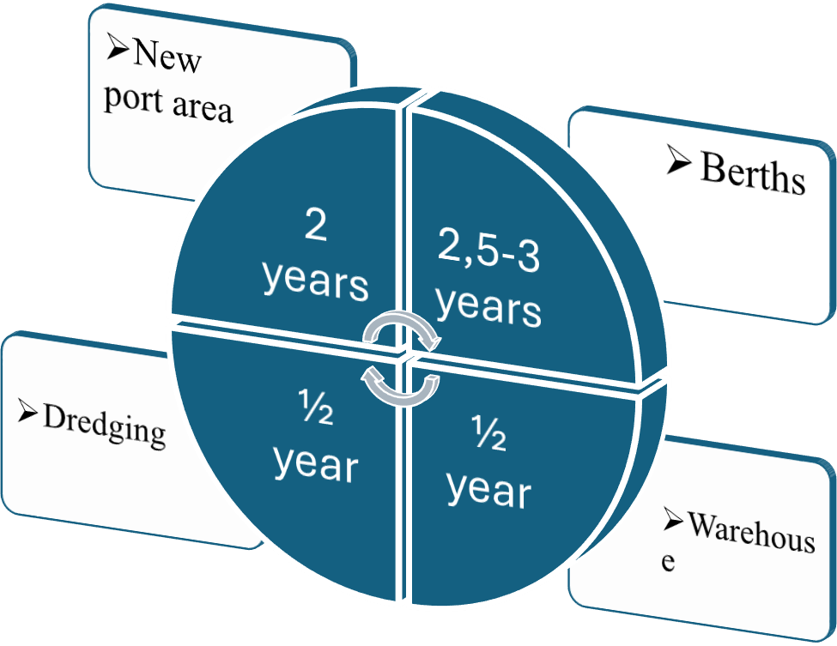
TIMEFRAME FOR DEVELOPNING PORT INFRASTRUCTURE
ATRACT AND RECEIVE FUNDING - EU, GOVERMENT, PORT, PRIVAT
2 YEARS
AGREEMENT WITH OWF OPERATOR

Slide 9
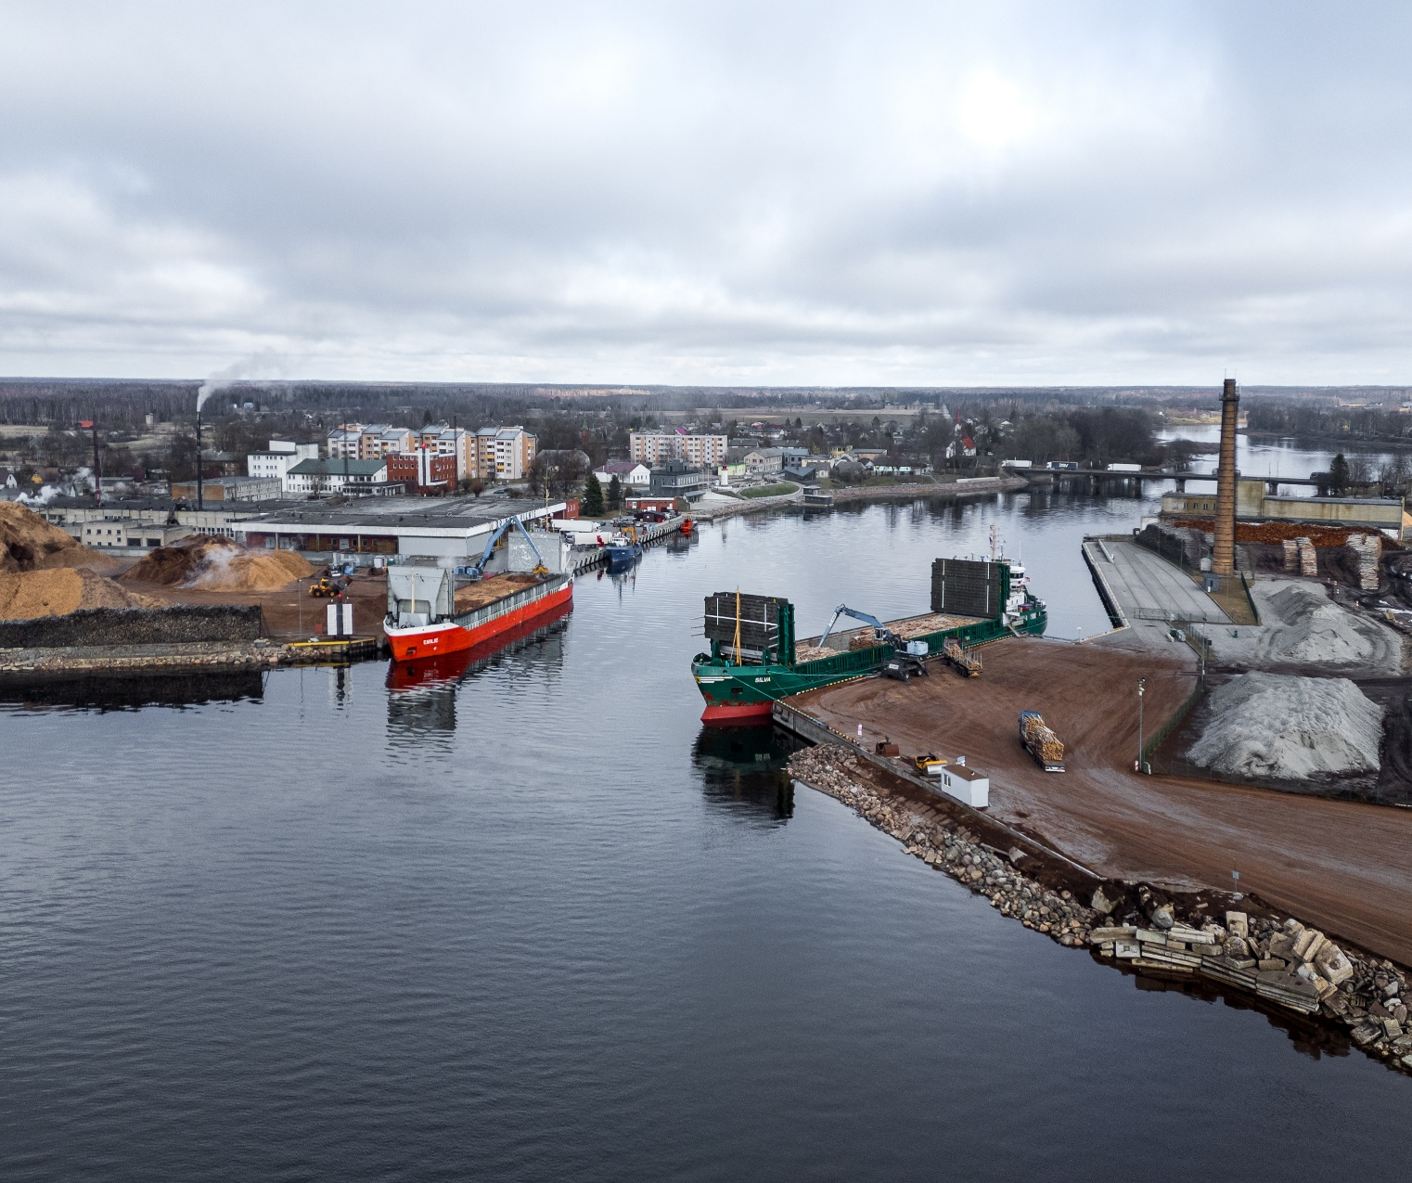
PORT OF SALACGRIVA
STRATEGIC CHOICE FOR WIND ENERGY HUB IN GULF OF RIGA
OPEN FOR POWER-TO-X SOLUTIONS
SALACGRIVA PORT AUTHORITY
OSTAS STR.6, SALACGRIVA, LATVIA
port@salacgrivaport.lv

